Slide 1

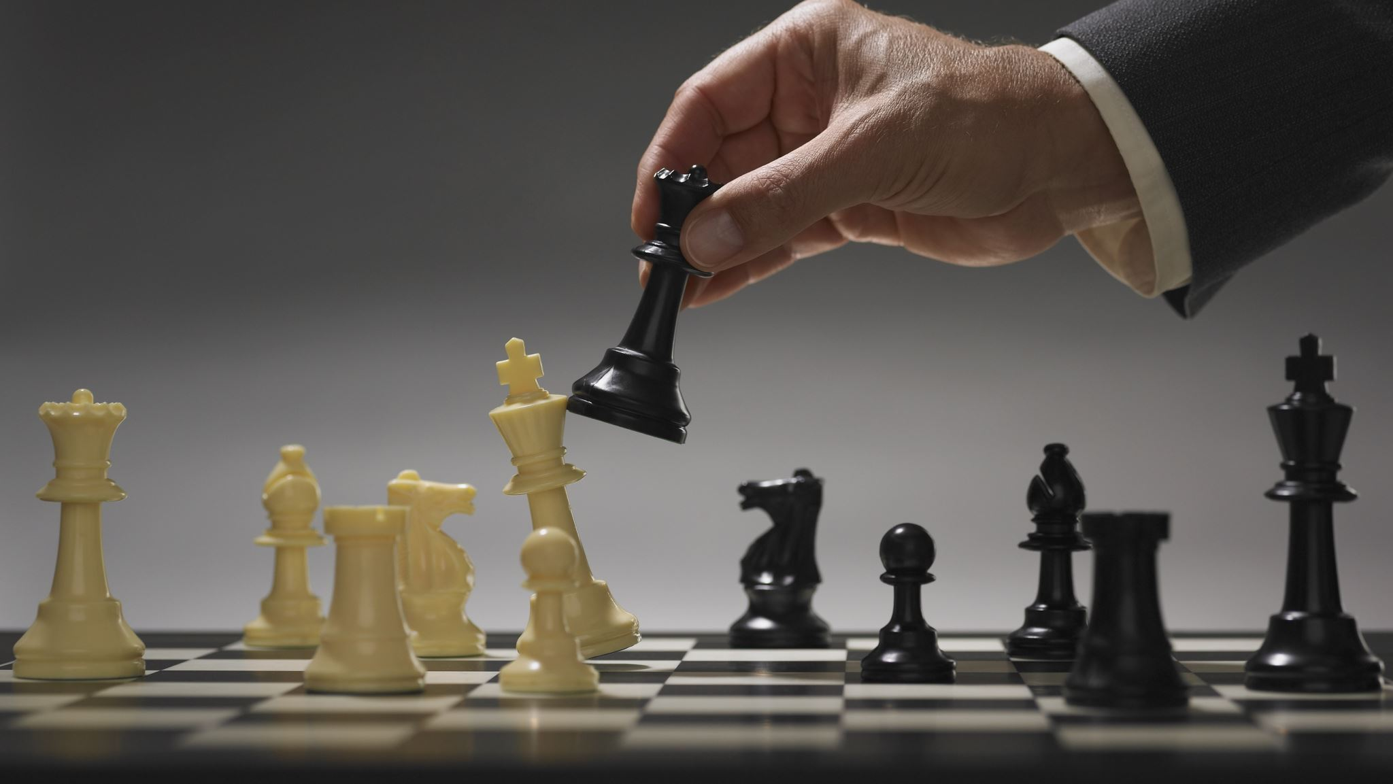
How to appear smart whilst playing chess
This probably isn’t going to make you any better but at least you won’t embarrass yourself

Slide 2
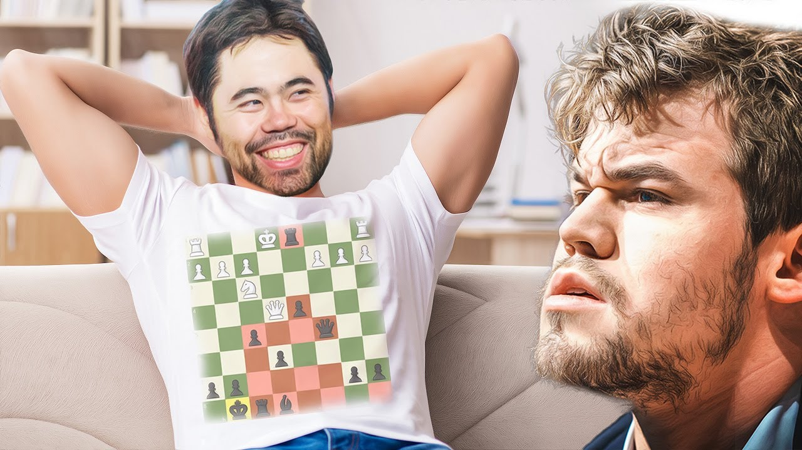
What is chess?
Game
It has a board and pieces and juicers
Things move
It looks smart
Yeh that's about it
See ya

Slide 3
Basic terminology
Legal move: Any move that is not against the rules and doesn't make it so your king can be captured
Check: King can be taken on the next move
Checkmate: King is in check and has no legal moves
Stalemate: King isn't in check but has no legal moves
Double attack: Attacking 2 pieces at once, not always going to win material
Fork: Attacking 2 pieces at once, guaranteed to win material
Blunder: Terrible move
Chess phases: Opening, middle-game, endgame

Slide 4
The pieces
The stuff that moves or something idk

Slide 5
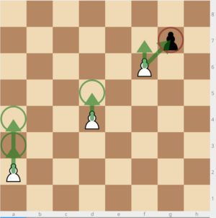
The juicer (pawn)
Moves forward one square... except for the times it doesn't

Slide 6
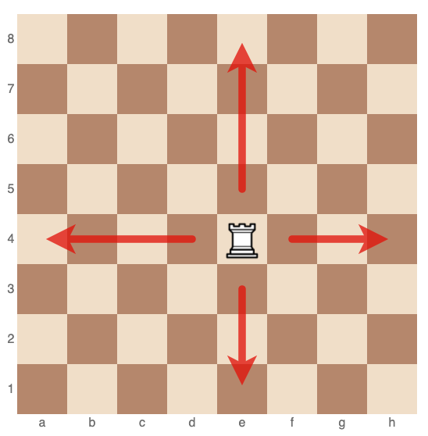
The tower (rook)
Can move horizontally and vertically

Slide 7
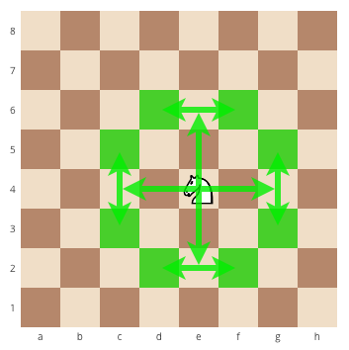
The horsie (knight)
The fact this doesn't make any sense to you is nothing you should be worried about. It doesn't make sense to anyone

Slide 8
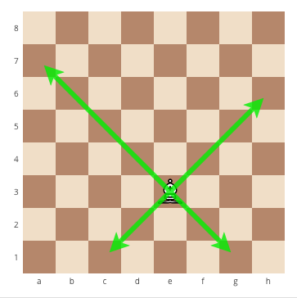
The biscuit (bishop)
Moves diagonally

Slide 9
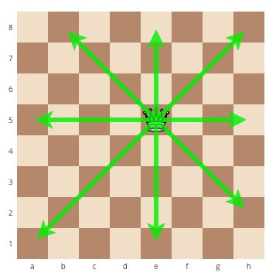
The only woman chess players will ever get to touch (queen)
This piece is too powerful, however it is said to have been nerfed as a part of Chess 2.0

Slide 10
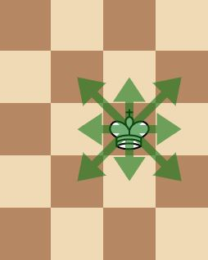
The baby (king)
Useless
Cannot really move
Nobody likes him
The reason you lose

Slide 11
Special moves
Weird, isn't it

Slide 12
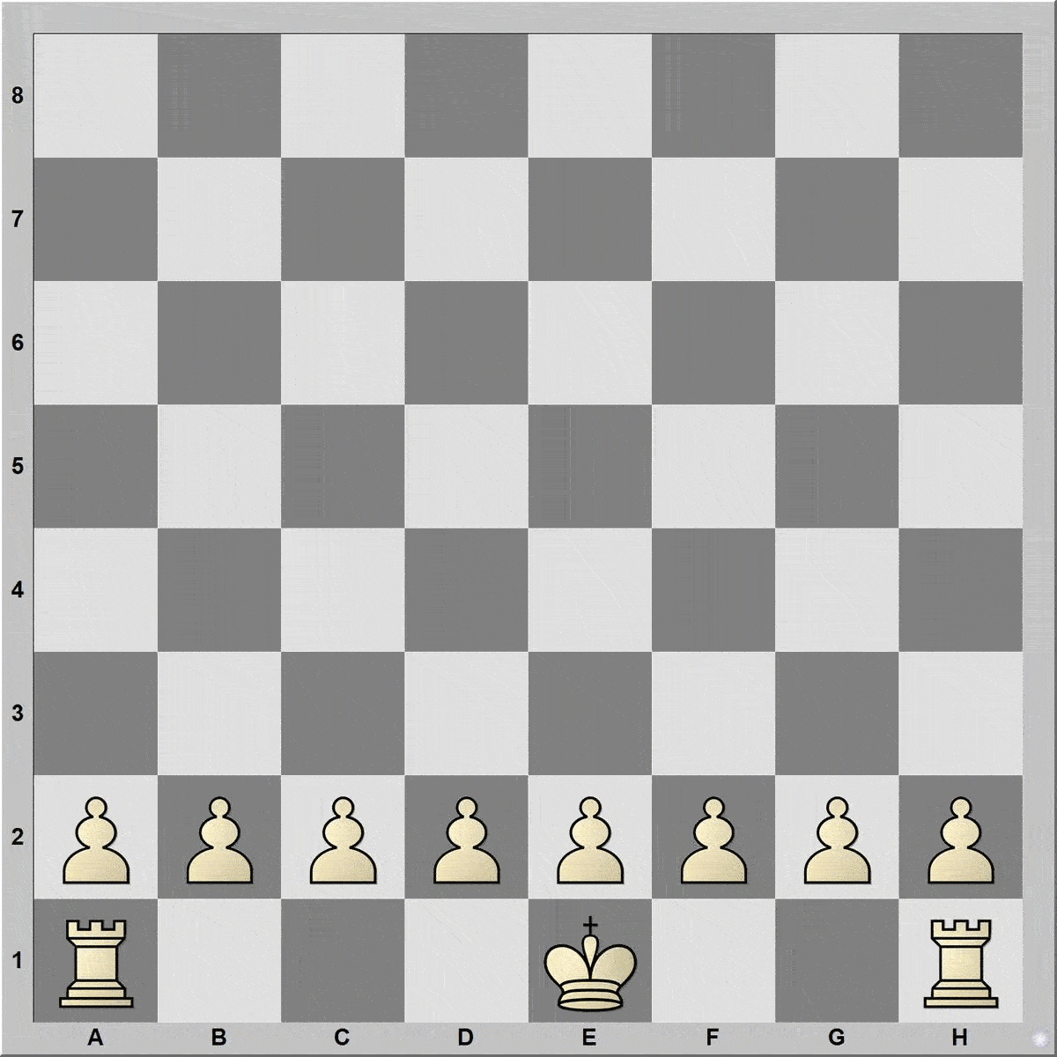
Castling
King moves 2 squares and rook jumps over it (that's like 3 moves in one, isn't that cool?)
Players can only do so once
Some other rules blah blah blah

Slide 13
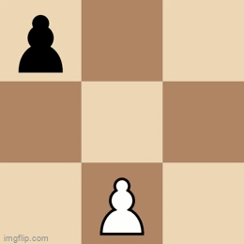
En passant (in passing)
Fancy
When pawn moves 2 squares forward it can be captured by another pawn as if it only ever moved one square forward, thus the pawn goes to an empty square and the pawn it is taking leaves the board
Forced (bricks to pipi)

Slide 14
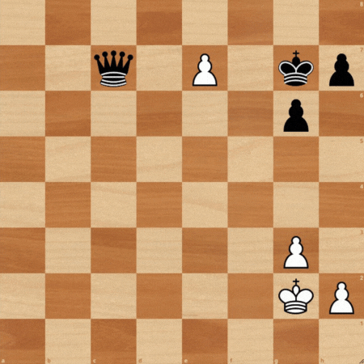
Promotion
Pawn gets a promotion for being strong and brave and travelling across the whole board
Can promote to: woman, horsie, tower, or biscuit

Slide 15
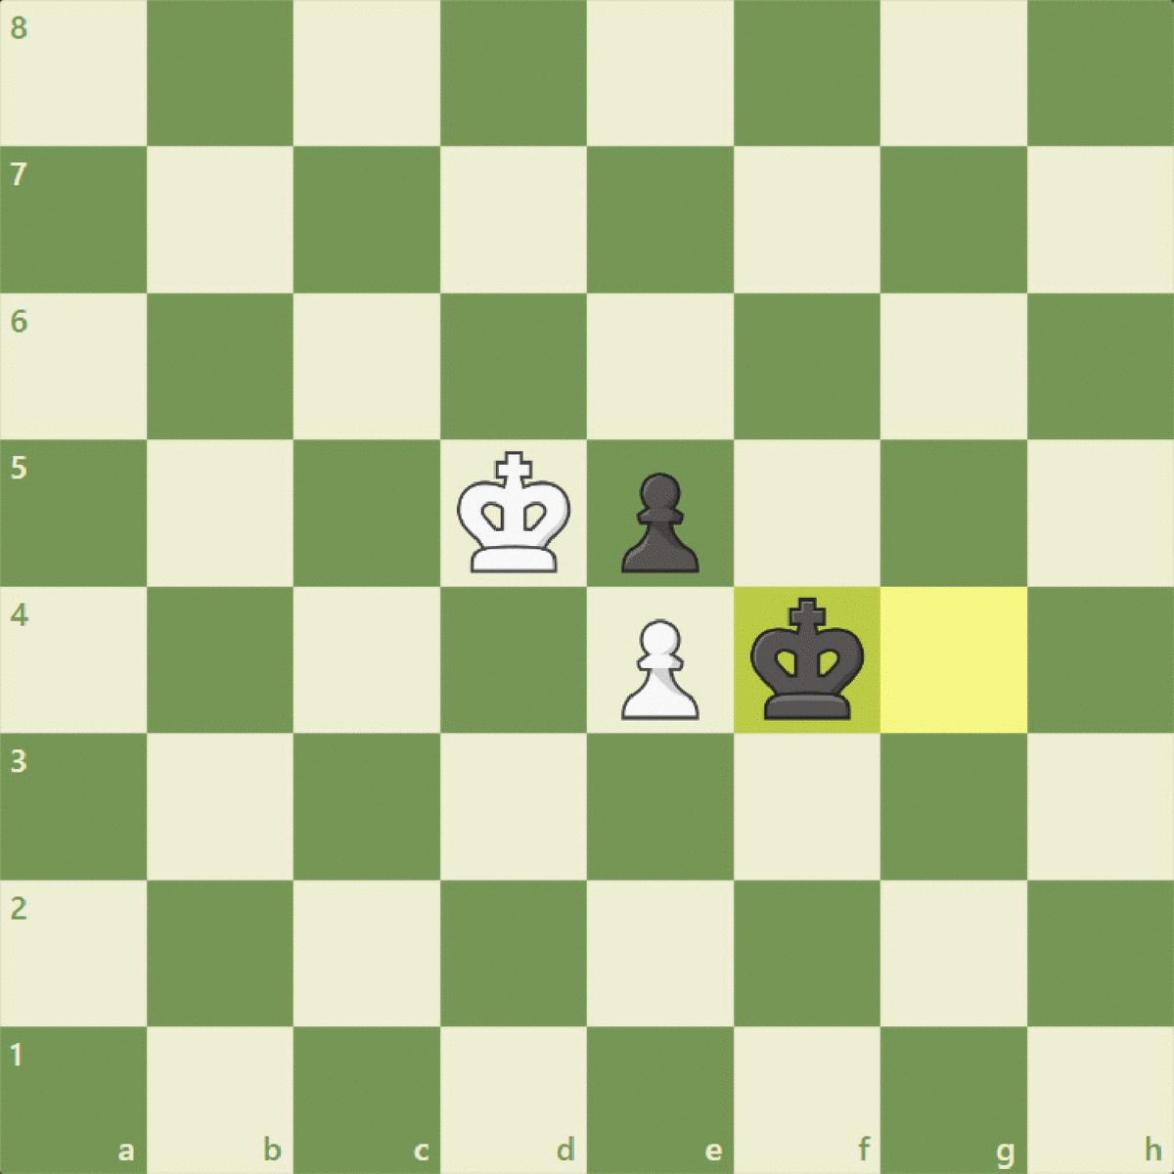
Zugzwang
Nobody wants to move

Slide 16
Opening theory
Common aims in opening plays
Development
Control of the center
King‘s safety
Prevention of pawn weakness
Piece coordination
Better position
Nomenclature
Opening – chosen by white
Defense – chosen by black
Variation – continuation of op
Gambit – op that involves sacrifice
Countergambit – gambit played by black, usually response to gambit
System – method of development
Attack – aggressive variation
Reversed, inverted – op played as other colour
Anti- - op that avoids specific line

Slide 17
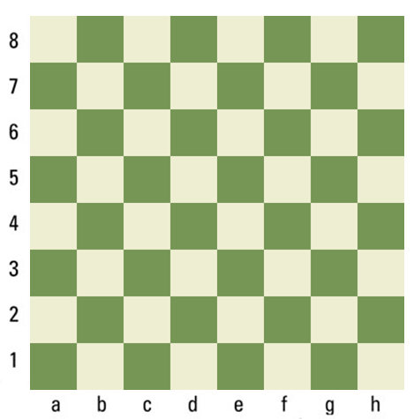





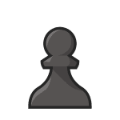
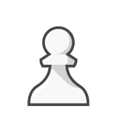





Bongcloud
Shows domimance over opponent (if you loose, don't forget to say you were just kidding)
Prevents castling, but only beta males castle anyways
Never lost in pro play
Always ends in a draw by repetition at a high level (Hikaru vs Magnus)

Slide 18
Tennison gambit
Trick opening that will only cause problems for Black if they play inaccurately
Trades material for development and chances to attack
Named after Danish-born player Lt. Col. Otto Mandrup Tennison
Only against bad players
Similar to Budapest gambit
Countered by Caro-Kann and French Defense

Slide 19
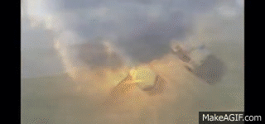
Tennison gambit: ICBM variation
The best variation of the Tennison gambit
Wins huge amount of material for white if not countered
Rumours have it this variation is widely popular amongst world leaders

Slide 20
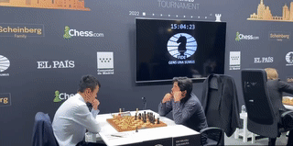
Ceiling trap
In order to trick your opponent to look away or to convince him that you are thinking ahead, you can use ceiling trap
This can give you time advantage or stress your opponent
It also looks very funny

Slide 21
